Slide 1
UNIT 4
TRANSACTION

Slide 2
TRANSCATION
Suppose we have to transfer Rs. 50 from Account A to Account B.
1.read(A)
2. A := A – 50
3. write(A)
4. read(B)
5. B := B + 50
6. write(B)
Here, all the 6 steps are called as transaction and it consists of 6 small actions which cannot be further divided.

Slide 3
A transaction can be defined as a group of tasks.
A transaction is a unit of program execution that occurs and updates various data items of a database.
A transaction can both read and write on the database.
Transaction is executed as a single unit.
If the database was in consistent state before a transaction, then after execution of the transaction also, the database must be in a consistent state.

Slide 4
Properties of Transaction
To ensure integrity of data, it is required that the database system possess the following properties of the transaction ACID properties.
Atomicity
Isolation
Consistency
Durability

Slide 5
Atomicity
A transaction is atomic if it is executed entirely or not at all.
If follows ALL or NOTHING principle.
If transaction fails at any step which has been executed partially, it should be undone.
Eg, transfer money(Amount, X,Y)

Slide 6
Consistency
Each transaction must leave the database in a consistent state.
Consistency requirement in above example:
The sum of A and B is unchanged by the execution of the transaction

Slide 7
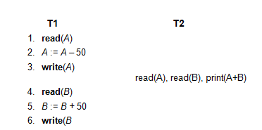
Isolation
If there are multiple transactions executing simultaneously, then all the transaction should be processed as if they are single transaction.

Slide 8
Durability
Once the DBMS notifies the user that the transaction has been successfully completed i.e., the transfer of the Rs. 50 has taken place,
the changes made to the database remain consistent , even if there is a system failure.

Slide 9
A transaction which is not successfully completed is called as aborted transaction and hence, to ensure the atomicity property, any changes made by aborted transaction are undone.
When changes made by aborted transaction are undone, the transaction is said to be a rollback transaction.
The transaction that has completed its execution successfully is said to be committed.

Slide 10
States of Transaction
Active – the initial state; the transaction stays in this state while it is executing
Partially committed – At any given point of time if the transaction is executing properly, then it is going towards it COMMIT POINT. The values generated during the execution are all stored in volatile storage.
Failed -- after the discovery that normal execution can no longer proceed. If the transaction fails for some reason. The temporary values are no longer required, and the transaction is set to ROLLBACK.

Slide 11
It means that any change made to the database by this transaction up to the point of the failure must be undone. If the failed transaction has withdrawn ` 100/- from account A, then the ROLLBACK operation should add 100/- to account A.
Aborted – after the transaction has been rolled back and the database restored to its state prior to the start of the transaction. Two options after it has been aborted:
Restart the transaction
can be done only if no internal logical error
Kill the transaction.

Slide 12
Committed – after successful completion. If no failure occurs then the transaction reaches the COMMIT POINT. All the temporary values are written to the stable storage and the transaction is said to have been committed
Terminated -- Either committed or aborted, the transaction finally reaches this state.

Slide 13
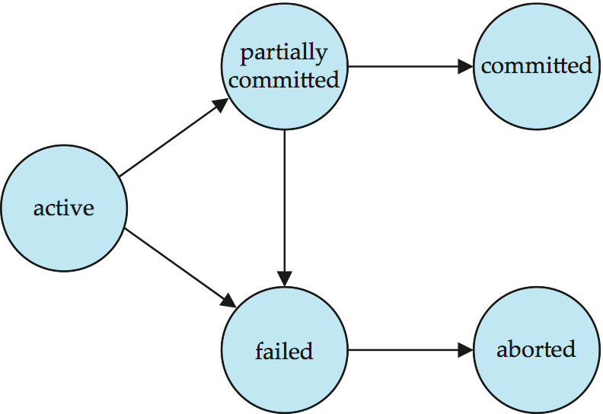

Slide 14
Concurrent Execution
Multiple transactions are allowed to run concurrently in the system. Advantages are:
Increased processor and disk utilization, leading to better transaction throughput
E.g. one transaction can be using the CPU while another is reading from or writing to the disk
Reduced average response time(reduced waiting time) for transactions: short transactions need not wait behind long ones

Slide 15
Schedules
A sequence of instructions that specify the chronological order in which instructions of concurrent transactions are executed.
A schedule for a set of transactions must consist of all instructions of those transactions
Must preserve the order in which the instructions appear in each individual transaction.

Slide 16
A transaction that successfully completes its execution will have a commit instruction as the last statement.
A transaction that fails to successfully complete its execution will have an abort instruction as the last statement

Slide 17
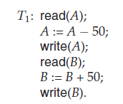
Consider the simplified banking system which has several accounts, and a set of transactions that access and update those accounts.
Let T1 and T2 be two transactions that transfer funds from one account to another. Transaction T1 transfers $50 from account A to account B. It is defined as

Slide 18
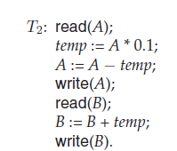
Transaction T2 transfers 10 percent of the balance from account A to account B. It is defined as,

Slide 19
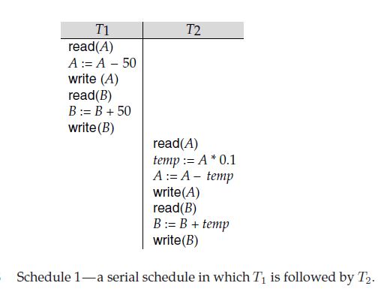
Schedule 1 Let T₁ transfer $50 from A to B, and T₂ transfer 10% of the balance from A to B. An example of a serial schedule in which T₁ is followed by T₂ :

Slide 20
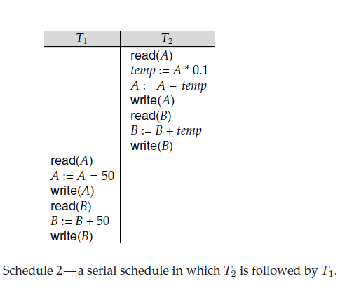
Schedule 2
A serial schedule in which T₂ is followed by T₁ :

Slide 21
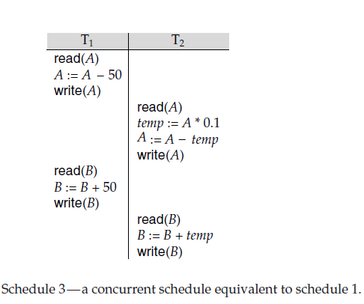
Schedule 3
Note -- In schedules 1, 2 and 3, the sum “A + B” is preserved.

Slide 22
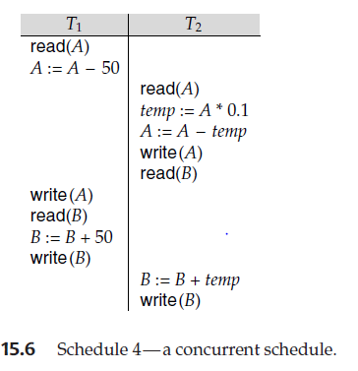
Schedule 4 note:- The following concurrent schedule does not preserve the sum of “A + B”

Slide 23
Serializability
It is sequences of actions i.e. read, write, commit, abort from set of transactions which obey the sequence of operations within the transactions.
Serial schedule- the schedules which gets executed one after other .
Interleaved schedule- the schedules which allows the parts of multiple transaction to get execute.

Slide 24
Simplified view of transactions
We ignore operations other than read and write instructions
We assume that transactions may perform arbitrary computations on data in local buffers in between reads and writes.
Our simplified schedules consist of only read and write instructions.

Slide 25
Basic Assumption – Each transaction preserves database consistency.
Thus, serial execution of a set of transactions preserves database consistency.
A (possibly concurrent) schedule is serializable if it is equivalent to a serial schedule. Different forms of schedule equivalence give rise to the notions of:
1. conflict serializability
2. view serializability

Slide 26
Conflict Serializability
It deals with detecting whether the instructions are conflicting in any way, and specifying the order in which these two instructions will be executed in case there is any conflict.
A conflict arises if the instructions belong to different transactions and if at least one(or both) of the instructions is a write operation.

Slide 27
Consider a schedule S in which there are two consecutive instructions, i and j of transactions Ti and Tj respectively.
If i and j belong to different data items, the execution may swap without affecting the result of any instruction in the schedule.
But if they belong to same data item Q, then the order may matter.

Slide 28
4 cases of executions are:-
1. i = read(Q), j = read(Q). i and j don’t conflict. 2. i= read(Q), j= write(Q). They conflict. 3. i= write(Q), j= read(Q). They conflict 4. i= write(Q), j= write(Q). They conflict

Slide 29
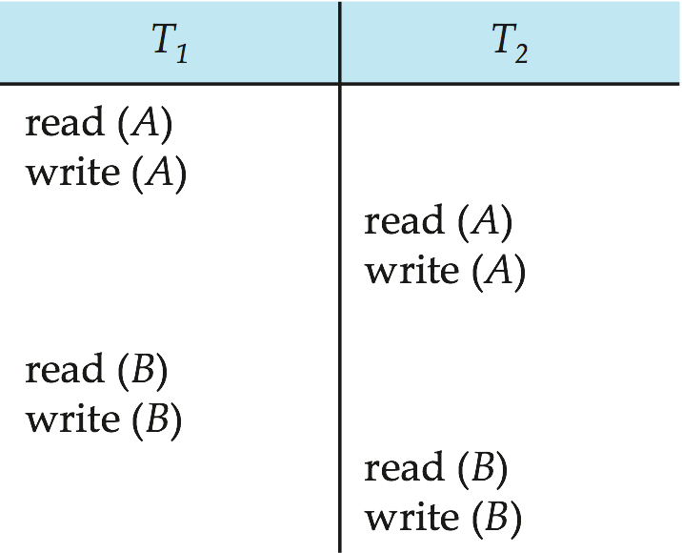
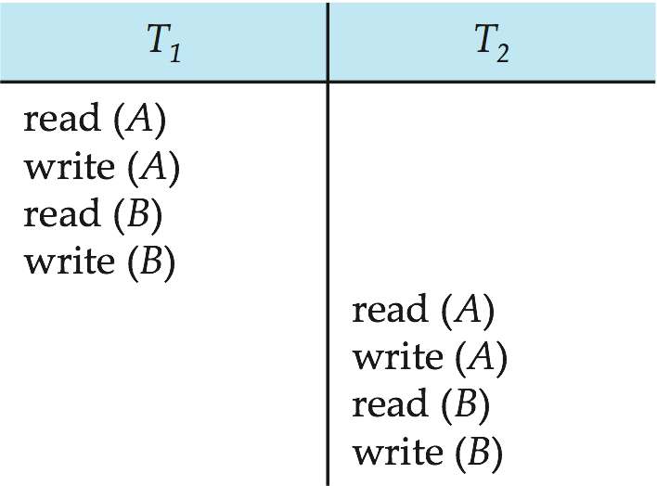
Schedule 1 can be transformed into Schedule 3 -- a serial schedule where T₂ follows T₁, by a series of swaps of non-conflicting instructions. Therefore, Schedule 1 is conflict serializable.
Schedule 1
Schedule 3

Slide 30
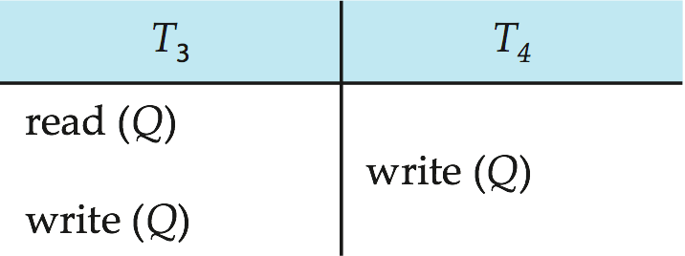
Example of a schedule that is not conflict serializable:
We are unable to swap instructions in the above schedule to obtain either the serial schedule < T₃, T₄ >, or the serial schedule < T₄, T₃ >.

Slide 31
View Serializability
It can be derived by creating another schedule out of an existing schedule, involving the same set of transactions.

Slide 32
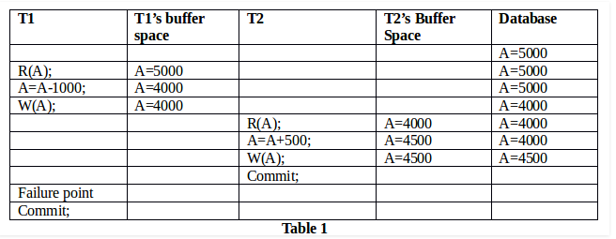
Recoverability
A transaction may not execute completely due to hardware failure, system crash or software issues. In that case, we have to rollback the failed transaction. But some other transaction may also have used values produced by failed transaction. So we have to rollback those transactions as well.

Slide 33
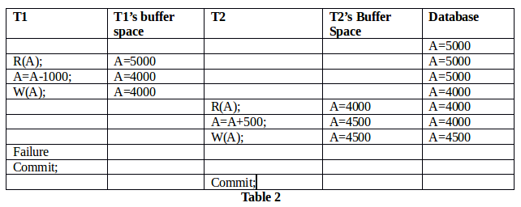
Table 2 shows a schedule with two transactions, T1 reads and writes A and that value is read and written by T2. But later on, T1 fails. So we have to rollback T1. Since T2 has read the value written by T1, it should also be rollbacked. As it has not committed, we can rollback T2 as well. So it is recoverable with cascading rollback.

Slide 34
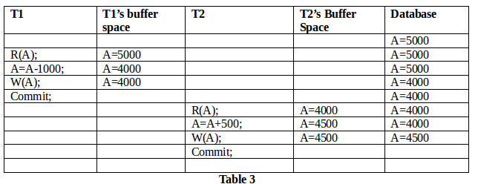
Table 3 shows a schedule with two transactions, T1 reads and writes A and commits and that value is read by T2. But if T1 fails before commit, no other transaction has read its value, so there is no need to rollback other transaction. So this is a cascadeless recoverable schedule.

Slide 35
CONCURRENCY CONTROL

Slide 36
Concurrency control is the process of managing simultaneous execution of transactions (such as queries, updates, inserts, deletes and so on) in a multiprocessing database system without having them interfere with one another.
Problems of Concurrency Control :
Lost update
Uncommitted dependency(Dirty Read Problem)
Inconsistent analysis problem

Slide 37
Lock Based Protocol
A lock is a mechanism to control concurrent access to a data item
Data items can be locked in two modes :
1. exclusive (X) mode. Data item can be both read as well as written. X-lock is requested using lock-X instruction.
2. shared (S) mode. Data item can only be read. S-lock is requested using lock-S instruction.
Lock requests are made to the concurrency-control manager by the programmer. Transaction can proceed only after request is granted.

Slide 38
Lock-compatibility matrix
A transaction may be granted a lock on an item if the requested lock is compatible with locks already held on the item by other transactions
If a lock cannot be granted, the requesting transaction is made to wait till all incompatible locks held by other transactions have been released. The lock is then granted.

Slide 39
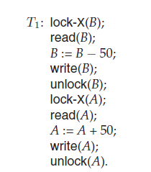
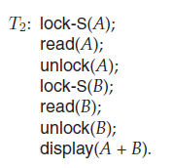
Example

Slide 40
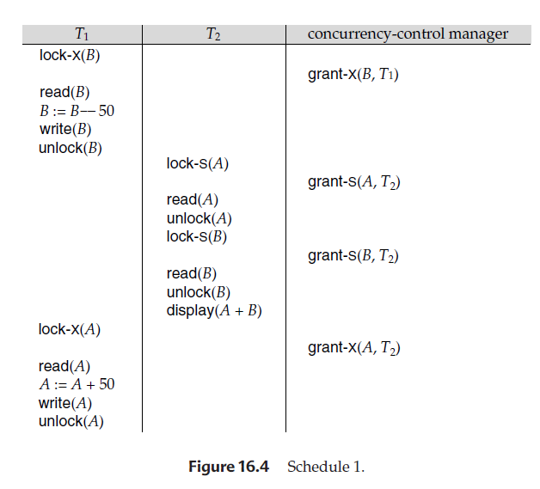
Concurrent execution

Slide 41
Two Phase Locking Protocol
This protocol ensures conflict-serializable schedules.
Phase 1: Growing Phase
Transaction may obtain locks
Transaction may not release locks
Phase 2: Shrinking Phase
Transaction may release locks
Transaction may not obtain locks
The protocol assures serializability. It can be proved that the transactions can be serialized in the order of their lock points (i.e., the point where a transaction acquired its final lock).

Slide 42
Strict Two Phase Locking (Strict 2PL): - This protocol is similar to 2PL in the first phase.
Once it receives the lock on the data, it completes the transaction. Here it does not release the locks as it is used and no more required.
It waits till whole transaction to complete and commit, then it releases all the locks at a time.
This protocol hence does not have shrinking phase of lock release.

Slide 43
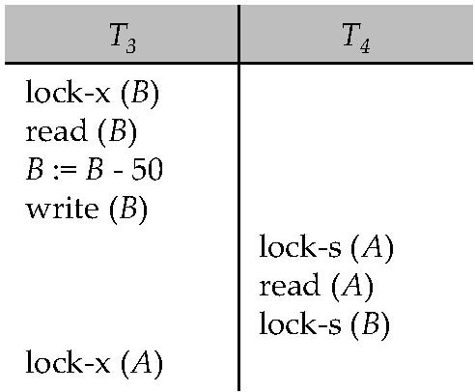
Deadlock
Consider the partial schedule
Neither T₃ nor T₄ can make progress — executing lock-S(B) causes T₄ to wait for T₃ to release its lock on B, while executing lock-X(A) causes T₃ to wait for T₄ to release its lock on A.
Such a situation is called a deadlock.
To handle a deadlock one of T₃ or T₄ must be rolled back and its locks released.

Slide 44
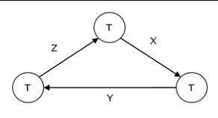
Deadlock
Deadlock is a state of a database system having two or more transactions, when each transaction is waiting for a data item that is being locked by some other transaction. A deadlock can be indicated by a cycle in the wait-for-graph.

Slide 45
Deadlock Handling
System is deadlocked if there is a set of transactions such that every transaction in the set is waiting for another transaction in the set.
Deadlock prevention protocols ensure that the system will never enter into a deadlock state. Some prevention strategies :
Require that each transaction locks all its data items before it begins execution (predeclaration).
Impose partial ordering of all data items and require that a transaction can lock data items only in the order specified by the partial order.

Slide 46
Two different lock prevention schemes are:-
Wait-die scheme- It states that when transaction Ti request a data item currently held by Tj, Ti is allowed to wait only if it has a smaller timestamp than that of Tj, otherwise Ti is rolled back.
Wound-wait scheme- when transaction Ti request a data item currently held by Tj, Ti is allowed to wait only if it has a larger timestamp than Tj otherwise it is rolled back.

Slide 47
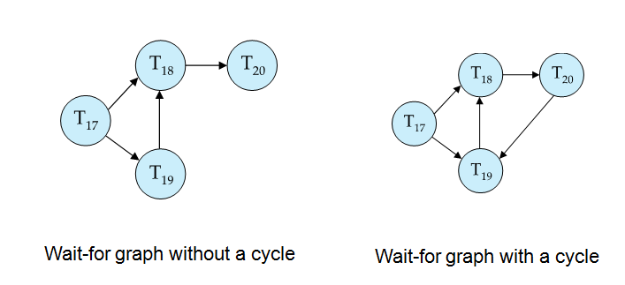
Deadlock detection and Recovery
The deadlock detection and removal approach runs a deadlock detection algorithm periodically and removes deadlock in case there is one.

Slide 48
Deadlock can be detected using directed graph called as wait-for graph.
If a cycle is present in wait-for graph then deadlock is present and transactions in cycle are a deadlock.

Slide 49
Recovery from deadlock
Methods for recovery from deadlock are:-
Select the victim- If deadlock is detected then a transaction is to be selected to break deadlock.
Rollback-
Total rollback- The entire transaction is aborted and restarted.
Partial rollback- Rollback only the transaction which is needed to break the deadlock.

Slide 50
3. Starvation- It may happen that every time the same transaction is selected as the victim which may rest towards the starvation of that transaction.
Starvation is a problem encountered in concurrent computing where a process is perpetually denied necessary resources to process its work.

